Slide 1
UI Delegation Pattern
For Data Controls in
WPF & Silverlight

Slide 2
UI Delegation Pattern 1.0
Initial Rough Draft – 1.0
Identify Problems (Markup Noise) with UI Markups
Reduce Markup Noise
Reduce Markup Lines of Code
Delegate UI Attributes to Custom Control
Naming Convention

Slide 3
UI Markup vs. Editor Files
UI Markup
Editor Files
Adheres to Open Standard
Easy to read
Can work without Editor
Less control over quality of Markup
Editor can fail on badly written markup
Leads to Markup Junk (Markup Noise).
Proprietary file format or generated code
Difficult to read
Can be difficult to work without Editor
More control over generated code
Editor does not fail on generated code
Leads to Editor Dependency

Slide 4
Markup Noise (Markup Junk)
Too many Visual Elements defined in one file leading to long lines in one file.
Too many inline attribute declaration is Markup Noise.
More time spent on text search within the markup.
Difficult to visualize markups, and multiple similar element can lead to mistakes.
Slowly the markup becomes junk to maintain.
UI Designers become extremely slow to load and edit markups.

Slide 5
How to reduce Markup Noise?
Appearance Delegation:
Delegate visual appearance to “Style” or “Themes” to clean up markup.
User Control, Window, Page all these markup containers should not have any visual appearance attributes.
Business Logic Delegation:
Don’t load “Static Data Lists (Country List, Language List, etc.)” (Drop Downs) in the markup.
Create custom controls / user controls for Data Controls (Combo Box, List Box)

Slide 6
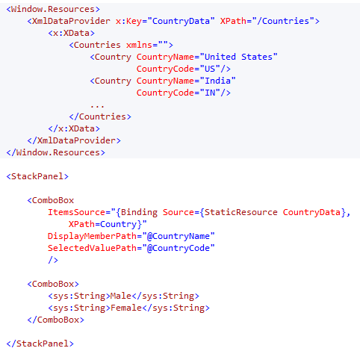
Bad Markup Example
First Combo Box loads country, the country xml resource is only specific to one combo box.
Second combo box loads inline drop down items for gender.
This way if you have more then 20 items, the page becomes junk to manage.
The Window/Page file is a “Connection Container” where only interdependent properties should be accessed/modified .

Slide 7
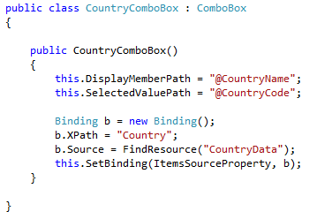
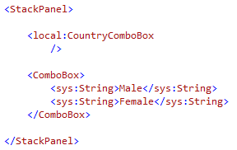
Custom Control For Countries
Create Custom Control “CountryComboBox”
Move Xml into Resources
In the constructor of control, set the binding to load Xml
Your markup looks like this.

Slide 8
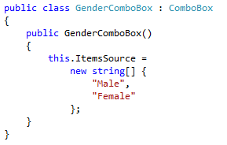
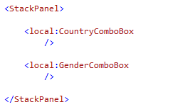
Custom Control For Gender
Create Custom Control “GenderComboBox”
Load String Array in the Constructor
And the final markup is shown below.
Now we have 3 files.

Slide 9
Lets Make Boundaries
The Connection Container (Window/Page) should only have interdependent Declarations.
List of countries has nothing to do with Gender, neither Gender list has anything to do with Country List. Both list should not be present or even accessible in the Connection Container.
This increases reusability.
This increases target focus while troubleshooting.

Slide 10
Thank you
Akash Kava’s Blog http://akashkava.com/blog
LinkedIn Profile http://in.linkedin.com/in/akashkava
NeuroSpeech UI Atoms & Research http://uiatoms.neurospeech.com

